Slide 1
DATA SCIENCE HACKATHON 2018 PREDICTING IDEAL LENGTH OF STAY FOR 30 DAY READMITTED VISITS
GROUP 2 – SAINT PETER’S UNIVERSITY
NANDINI KHATOD
PREETHI RAVI
PRANAY KATTA
VINOTHINI PUSHPARAJA
EBERLYNE LEGERME

Slide 2
OBJECTIVES
PREDICTING THE IDEAL LENGTH OF STAY FOR LIVER PATIENTS WHO GOT READMITTED WITHIN FIRST 30 DAYS OF THEIR INDEX ADMISSION
CALCULATING COST SAVED PER VISITLINK

Slide 3
Findings
Average increase in LOS for index VisitLinks = 2.95 ~ 3 days
Average Cost Saved per VisitLink = $56,523.94
By increasing average LOS by 2.95 or 3 days in first index visit $56,523.94 costs will be saved on an average per VisitLink.
By staying 3 more days on the index visit, 3 extra days or 6 days in total of stay during readmission can be eliminated on an average
High correlations are found between ADC (Average daily Census), ADMTOT (Total Facility Admissions), BDTOT (Total Beds Staffed)

Slide 4
Process flow
Understanding the Problem Statement
Exploratory Data Analysis
Data Cleaning and Pre-Processing
Formulating Train /Test Sets
Feature Selection
Model Building
Evaluation of Model Performance
Generating Insights

Slide 5
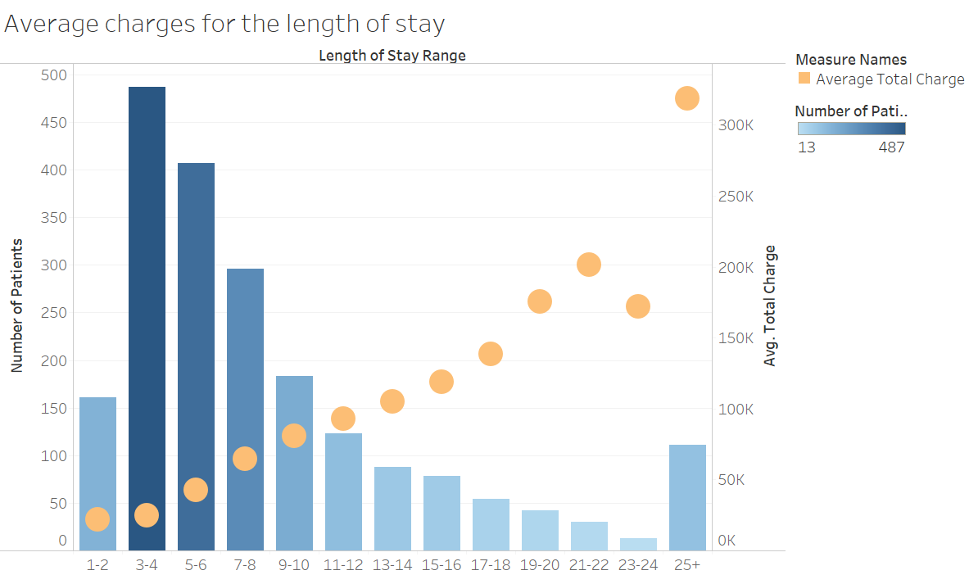
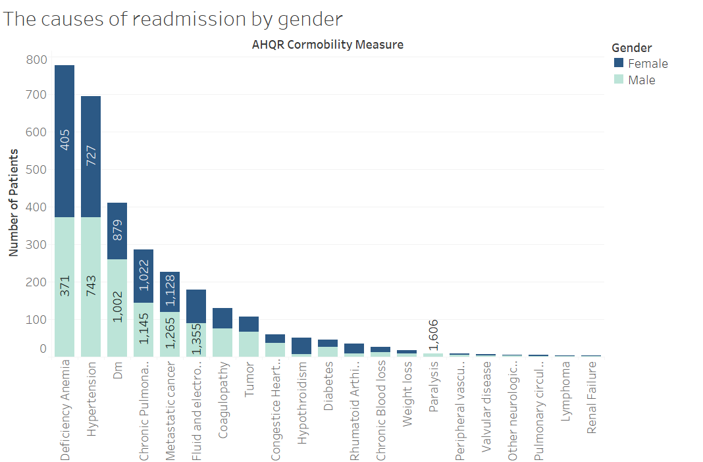
Exploratory data analysis

Slide 6
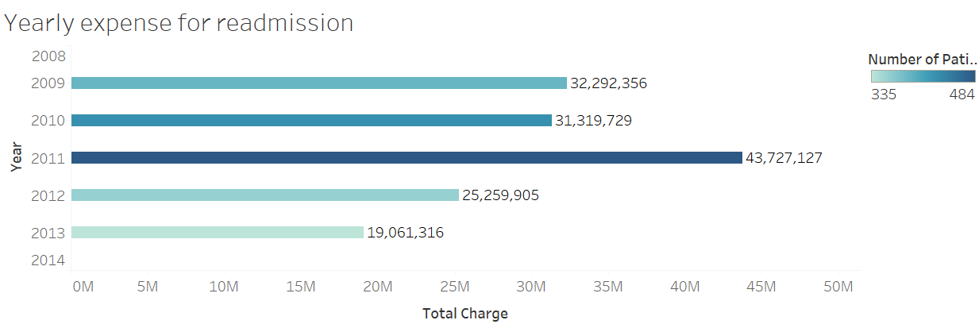
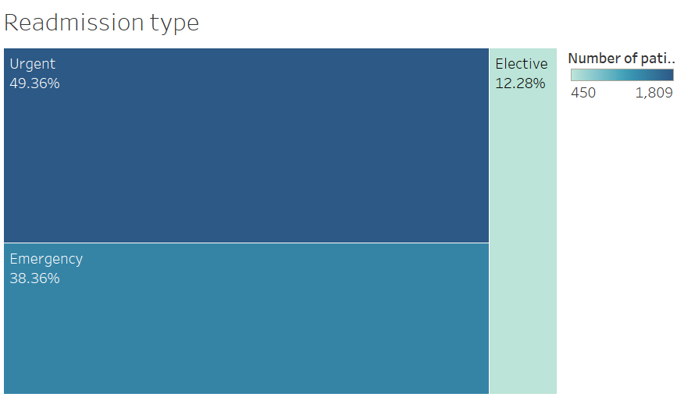

Slide 7
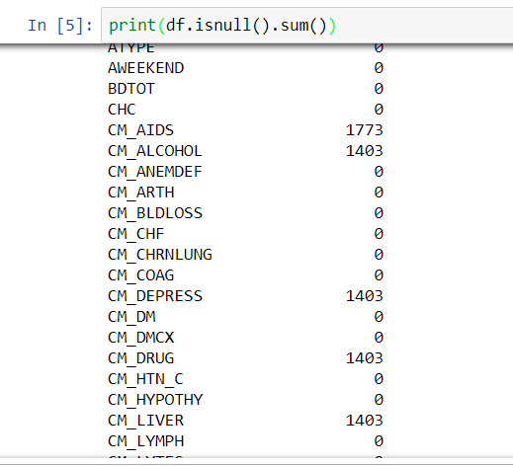
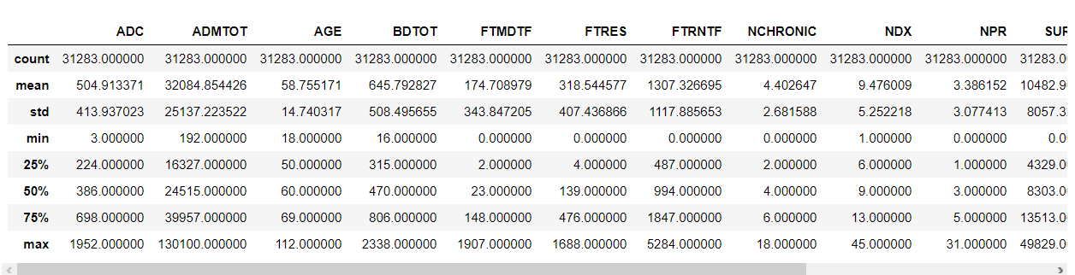
Data cleaning and pre-processing
Exploring Five-number summary of variables.
Imputing Missing Values:
A) For Comorbidities Measure: Default to 0
B) For Multivalued Categorical: Default to ‘Others’.
C) For Binary Categories: Random(0,1)
D) For Continuous: Mean

Slide 8
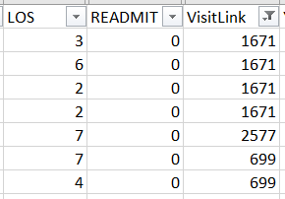
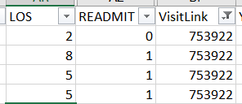
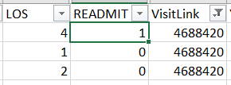
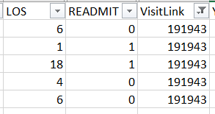


Identifying good and bad visits
GOOD VISITS
READMISSION VISITS
BAD VISITS
INDEX

Slide 9
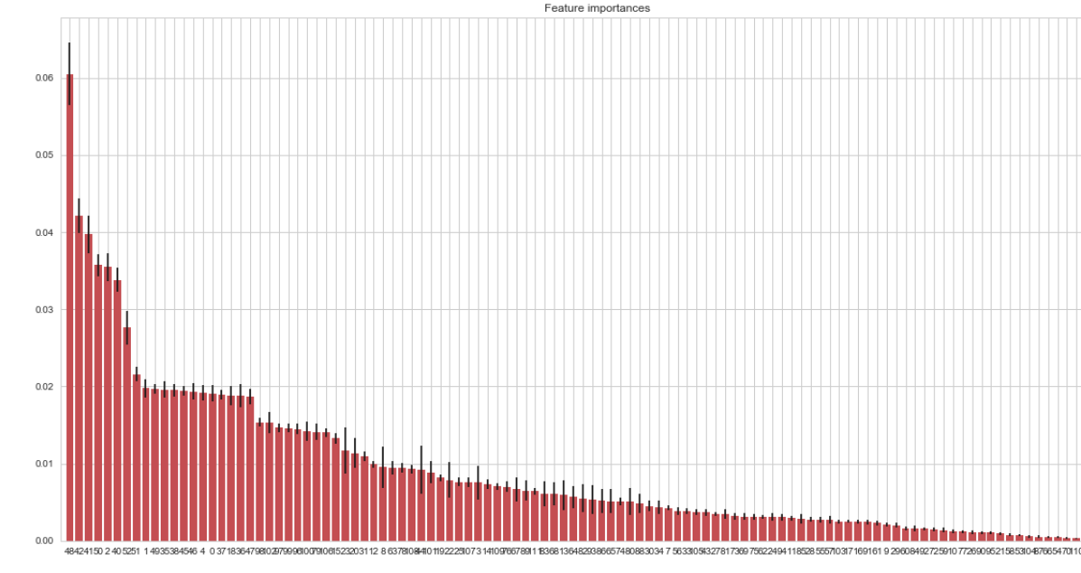
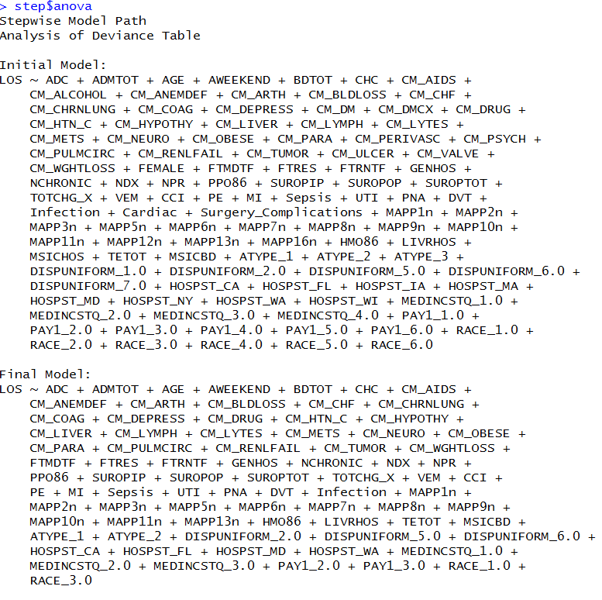
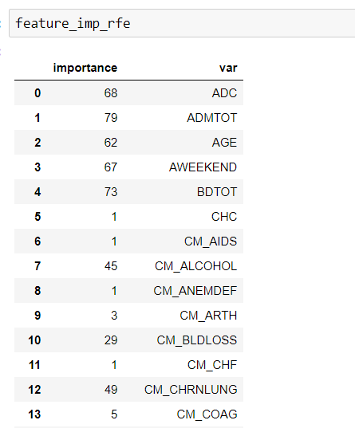
Feature selection
STEPWISE AIC
EXTRA TREES CLASSIFIER
RECURSIVE FEATURE ELIMINATION

Slide 10
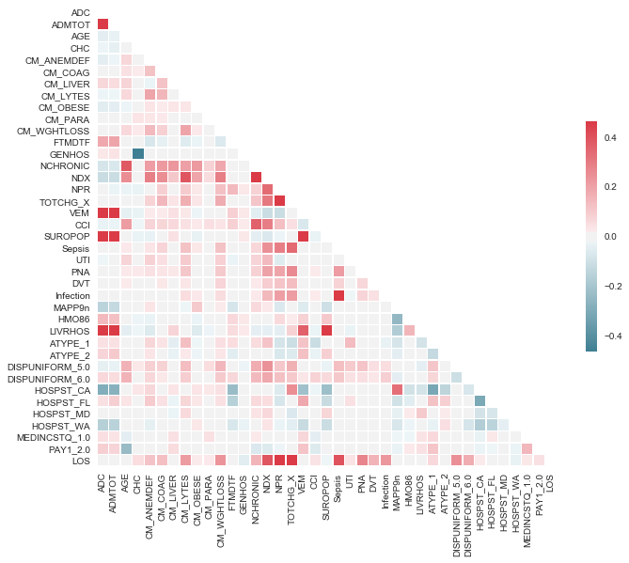
CORRELATION MATRIX

Slide 11
Data modeling
StatModels: Ordinary Least Squares
Sklearn: Multilinear Regression
Random Forest
Support Vector Regression

Slide 12
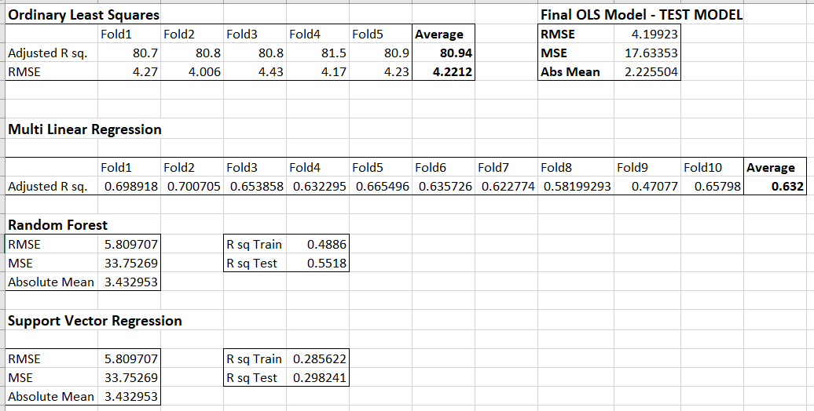
Evaluating Model Performance

Slide 13
CALCULATION OF COST SAVED
Cost Saved per VisitLink =
CHG_Per_Visit * (Total_LOS (Including READMITS following an Index Visit) – Ideal_LOS (Predicted))
CHG_Per_Visit = Total_CHG
Total_LOS

